Slide 1
parallel & perpendicular lines
Wolff Algebra 1H

Slide 2
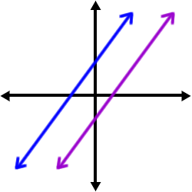
Parallel lines ||
Never intersect
Same slope
Different y-intercepts

Slide 3
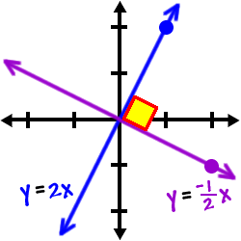
Perpendicular Lines |
Intersect at right angles
Opposite reciprocal slopes
Exception: vertical/horizontal lines that have slope of zero/undefined

Slide 4
Model 1
Write an equation in point-slope form for the line that passes through (4,-1) and is parallel to the graph of y = ¼ x + 7
y + 1 = ¼ (x – 4)
x & y coordinates on the parallel line
Same slope

Slide 5
Model 4
Write an equation in slope-intercept form for the line that passes through (4,7) and is perpendicular to the graph of y = 2/3 x – 1
y – 7 = - (x – 4)
y – 7 = - x + 6
+ 7 + 7
y = - x + 13
3
2
Enter in the point you know and the opposite reciprocal slope
3
2
3
2

Slide 6
Practice with a partner
Write an equation in slope-intercept form for the line that passes through (4,-2) and is parallel to the graph of y = ½ x – 7

Slide 7
Test yourself individually
Write an equation in slope-intercept form for the line that passes through (4,-1) and is perpendicular to the graph of 2x – 2y = 3

Slide 8
Model 2
On the plans for a treehouse, a beam represented by QR has endpoints Q(-6,2) and R(-1,8). A connecting beam represented by ST has endpoints S(-3,6) and T(-8,5). Are the beams perpendicular? Explain.
Slope QR = 8 – 2 Slope ST = 5 – 6
-1 + 6 -8 + 3
= 6 = -1 = 1
5 - 5 5
6/5 and 1/5 are not opposite reciprocals so no, not perpendicular

Slide 9
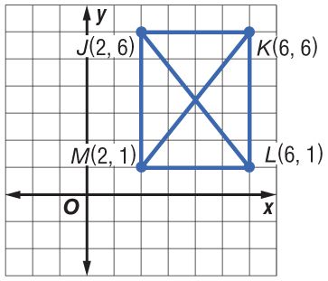
Collaborate
The graph shows the diagonals of a rectangle. Determine whether JL is perpendicular to KM.

Slide 10
Model 3
Determine whether the graphs of 6x – 2y = -2, y = 3x – 4, and y = 4 are parallel or perpendicular. Explain.
6x – 2y = -2 y = 3x – 4 y = 4
-6x -6x Slope: 3, y-int: -4 Slope: 0, y-int: 4
-2y = -6x – 2
-2 -2 -2
y = 3x + 1
Slope: 3, y-int: 1
6x – 2y = -2 and y = 3x – 4 have the same slopes and different y-intercepts so they are parallel lines. Y = 4 is a horizontal line so it is not parallel or perpendicular to either of the others.

